Slide 1
Algorithm Analysis
Defining & Evaluating Algorithms

Slide 2
Revision: Properties of an Algorithm
All algorithms should have the following properties:
Finite – the algorithm should always terminate
Defined – Every action the algorithm needs to take should be specifically defined (no fuzziness allowed)
Inputs – All algorithms should have 0 or more inputs
Output – All algorithms should have an output
Effectiveness – An algorithm is expected to work! It should also work in a reasonable amount of time.
How can we tell without running it??

Slide 3
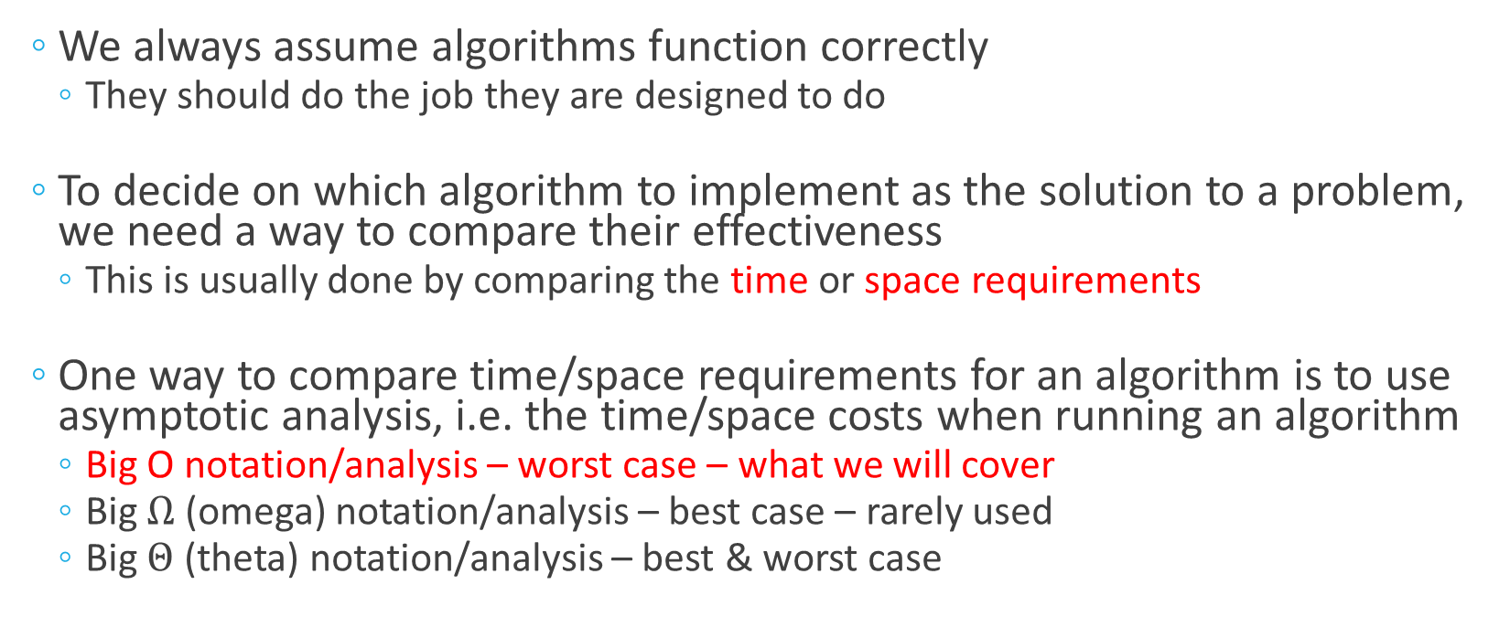
Comparing Algorithms
We always assume algorithms function correctly
They should do the job they are designed to do
To decide on which algorithm to implement as the solution to a problem, we need a way to compare their effectiveness
This is usually done by comparing the time or space requirements
One way to compare time/space requirements for an algorithm is to use asymptotic analysis, i.e. the time/space costs when running an algorithm
Big O notation/analysis – worst case – what we will cover
Big $Ω$ (omega) notation/analysis – best case – rarely used
Big $Θ$ (theta) notation/analysis – best & worst case

Slide 4
Comparing Algorithms with Big O
Big O allows us to compare algorithms without worrying about:
The hardware they’re running on
Any other “background noise” on the computer executing the algorithms
Big O also allows us to compare how things will perform as they scale up
How will an algorithm perform when it is run on a dataset of 3000?
How will the same algorithm perform when it’s run on a dataset of 3,000,000?

Slide 5
Big O Analysis
Big O analysis measures the worst-case execution time/space requirements of an algorithm relative to its input size
This is referred to as the “order” of the algorithm
Allows us to rate algorithm efficiency/cost so they can be compared
Big O analysis is always discussed relative to the size of the input as that’s the major impact factor on how long an algorithm will take to execute!
We discard constant values and multipliers because they have such a small impact relative to changing the data size

Slide 6
Common “Order” / Complexity Values
O(1) - Fixed
O(N) - Linear
O(N²) - Quadratic
O(log N) - Logarithmic
O(N log N) - Linearithmic
O(2^{N}) - Exponential*
Most of what we’ve done so far lives here!
We’ll be doing some examples from here soon
Notes:
* Not in the scope of the course

Slide 7
Basic Complexities: Fixed Complexity
O(1) – Has an order of 1
The algorithm/line of code will take the exact same time to complete, no matter how much input is provided
Fixed complexity algorithms will never contain non-constant loops
Example:
public static boolean hasFirstElement(String [] elements){ return elements[0] != null; }

Slide 8
Basic Complexities: Linear Complexity
O(N) – has an order of N (where n is the input size)
The algorithm/line of code’s time/space requirements will grow linearly in proportion to the input size
A single for loop iterating from start to end of a data set has linear complexity
Example:
public static boolean contains(String [] elements, String e){ for(String current: elements){ if(current.equals(e)){ return true; } } return false; }
Notice how the extra steps don’t count as part of the complexity? We’ll get to this.

Slide 9
Another Example of Linear Complexity – Linear Search
Linear search: checking each element in an array, one after the other
Only stop when either:
You find a match OR
You reach the end of the array
Algorithm in practice:
for(int i = 0; i < arr.length; i++){
if(arr[i] == value){
return i; // Found the value, so return its position
}
}
return -1; // Didn’t find a match in any slot, so return that there was no match
Just like the previous algorithm, go through the entire array once at most

Slide 10
Basic Complexities: Quadratic Complexity
O(N²) – has an order of N² (where N is the input size)
The time/space requirements of the algorithm/line of code are directly proportional to the square of the input size
This is caused by nested loops - the more nested layers, the higher the power value
One layer of nesting causes O(N²)
Two layers of nesting causes O(N³)
Three layers of nesting causes O(N⁴)
Etc…

Slide 11
Basic Complexities: Quadratic Complexity (2)
Example:
public static boolean containsDuplicates(String [] values){
for(int outer = 0; outer < values.length; outer++){
for(int inner = outer+1; inner < values.length; inner++){
if(values[outer].equals(values[inner]))
return true;
}
}
return false;
}
Even though the inner loop does not hit EVERY entry in the data set, it’s still considered to be the full N elements
Another example of discarding the constants!

Slide 12
Complex Complexities: Logarithmic Complexity
O(log N) – has an order of log N (where N is the input size)
Algorithm where the input data size is halved at every iteration
The growth rate of the time/space requirements starts high, then decreases rapidly
Example 1) : Binary search
Example 2) : Navigating through a binary tree

Slide 13
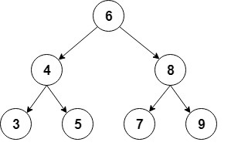
Logarithmic Complexity - Example
Navigating a binary tree:
At each step, half of the remaining data in the tree is discarded
How many iterations/comparisons would be required to navigate this tree?

Slide 14
Complex Complexities: Linearithmic Complexity
O(N log N) – Order of N log N
The logarithmic section of the algorithm (where data is repeatedly divided in half) is done a linear amount of times
Example: Merge sort
Data is divided in half at every stage until the end of the data is reached
This is done using the pivot partitioning we did earlier!
Once the data has been fully divided up, it’s merged back together in order (this step is done N times)
Notes:
Awareness only!

Slide 15
Complex Complexities: Exponential Complexity
O(2^{N}) – Order of 2^{N} (where N is the input size)
The opposite to logarithmic complexity – growth doubles with every addition to the size of the input
Growth starts off slow and then increases at a very high rate!
In code, each iteration produces two more
Example:
public static int fibonacci(int num){
if(num <=1 ){
return num;
}
else{
return fibonacci(num-1) + fibonacci(num-2);
}
}
This is recursion, i.e. when you call a method from within itself
Notes:
Awareness only!

Slide 16
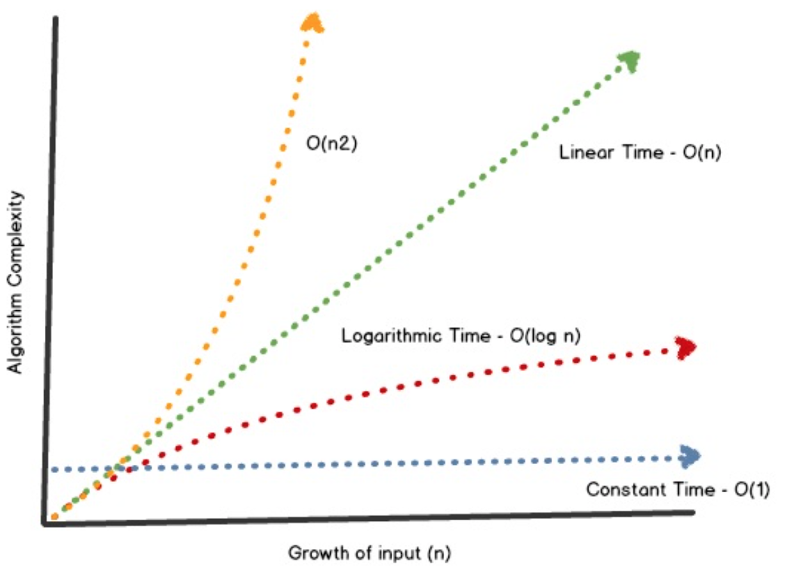
Comparing Complexities
Fixed/constant time is usually best
At low input sizes, there is very little difference in complexities
When input size increases, best to aim for logarithmic complexity

